Slide 1


Raspberry Pi 3
H. Melih Erdogan
Lab Assistant
Intelligent Robotics I - ECE 478/578
Electrical and Computer Engineering Department Maseeh
College of Engineering and Computer Science

Slide 2
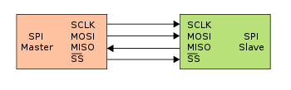
SPI Serial Periheral Interface
The Serial Peripheral Interface (SPI) bus is a synchronous serial communication interface specification used for short distance communication, primarily in embedded systems.
SPI devices communicate in full duplex mode using a master-slave architecture with a single master. The master device originates the frame for reading and writing. Multiple slave devices are supported through selection with individual slave select (SS) lines.

Slide 3
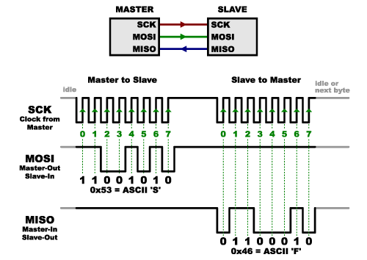
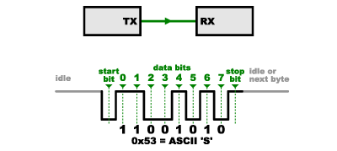
Why SPI?
It is cheaper, synchronized, multiple slaves, faster.
There is no control over when data is sent or any guarantee that both sides are running at precisely the same rate
The clock is an oscillating signal that tells the receiver exactly when to sample the bits on the data line.
The master always generates the clock signal, it must know in advance when a slave needs to return data and how much data will be returned.

Slide 4
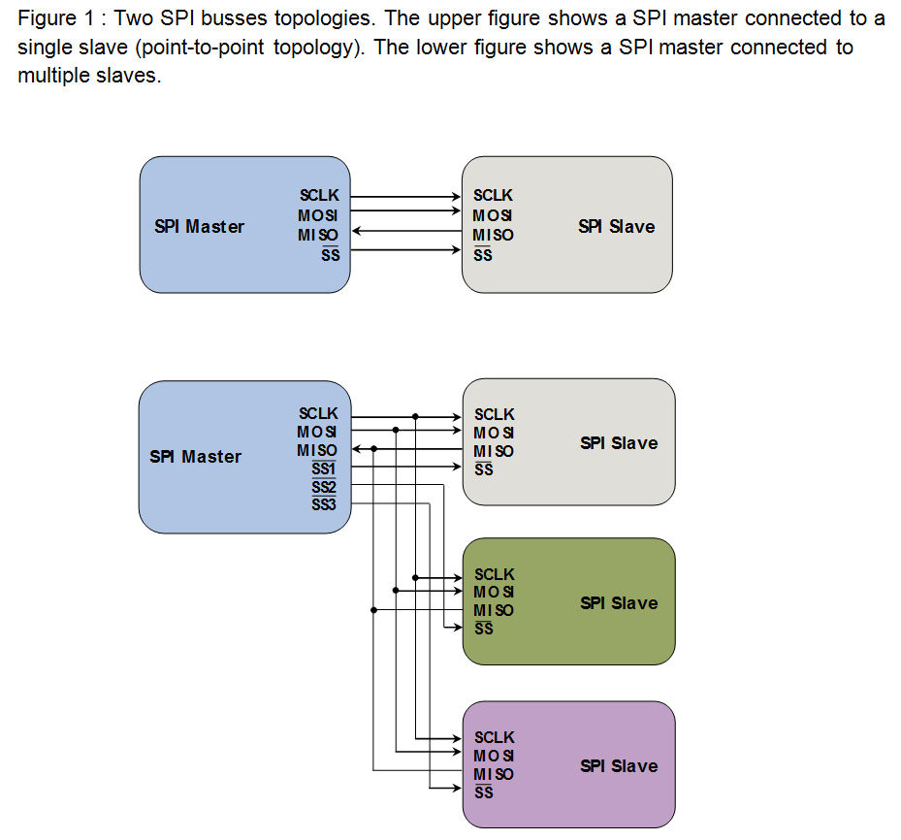
SPI - Master and Slave
- A clock signal named SCLK, sent from the bus master to all slaves; all the SPI signals are synchronous to this clock signal; – A slave select signal for each slave, SSn, used to select the slave the master communicates with; – A data line from the master to the slaves, named MOSI (Master Out-Slave In) – A data line from the slaves to the master, named MISO (Master In-Slave Out).

Slide 5
Spidev 3.2
https://pypi.python.org/pypi/spidev

Slide 6
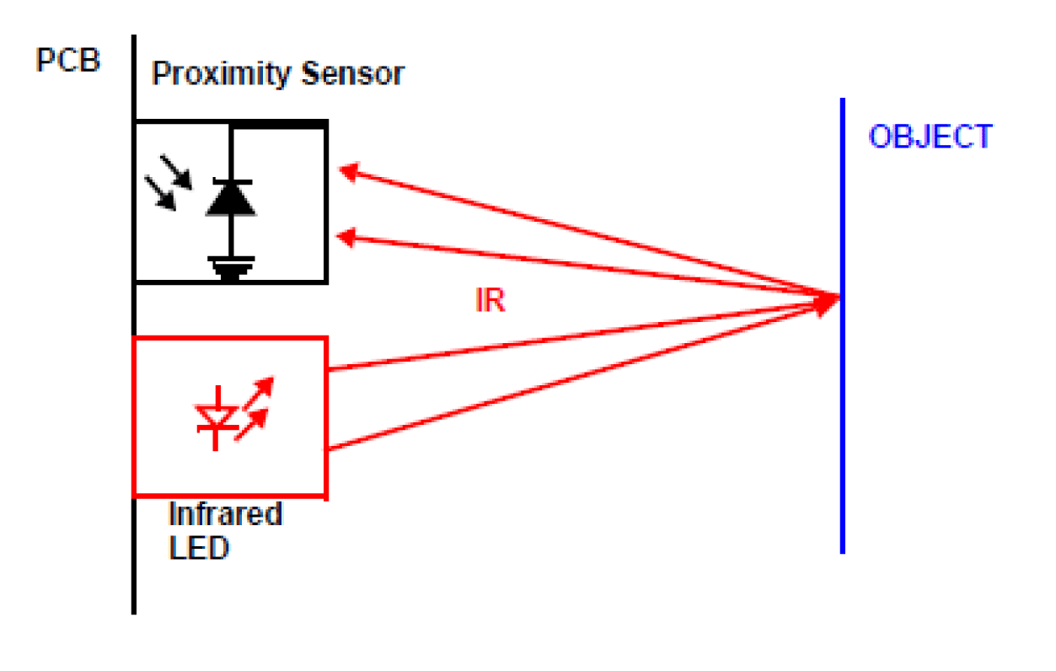
IR Distance Sensor

Slide 7
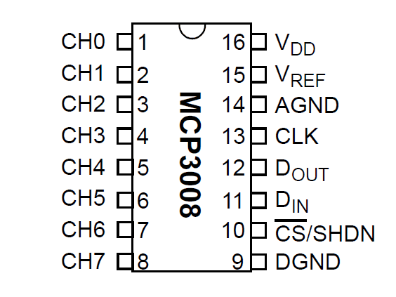
MCP3008 - ADC
An Analog to Digital Converter (ADC) converts an analog voltage on a channel to a digital number.

Slide 8
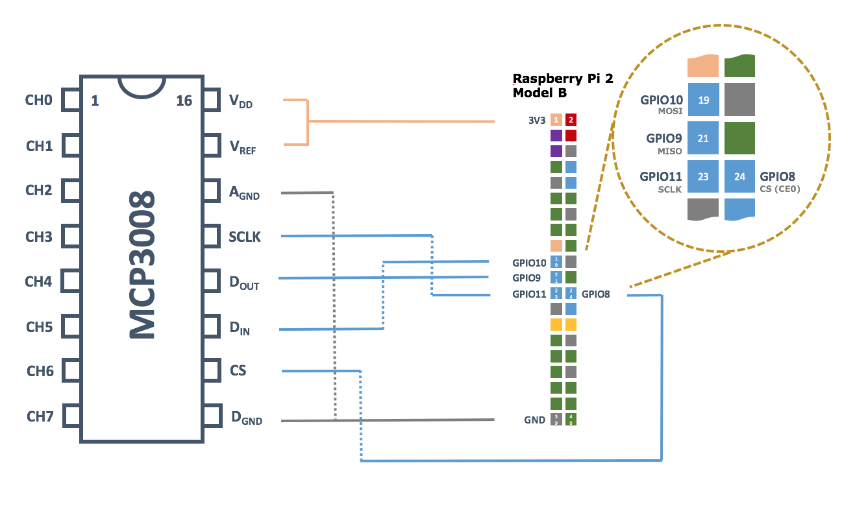

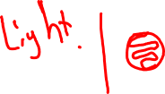
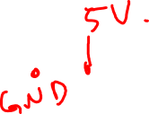

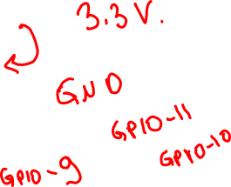














Circuit Design

Slide 9
Pin Connections
GPIO8 = Pin 24 on Raspberry => CS = Pin 10 on MCP3008
GPIO10 = Pin 19 on Raspberry => Din = Pin 11 on MCP3008
GPIO9 = Pin 21 on Raspberry => Dout = Pin 12 on MCP3008
GPIO11= Pin 23 on Raspberry => SCLK = Pin 13 on MCP3008

Slide 10
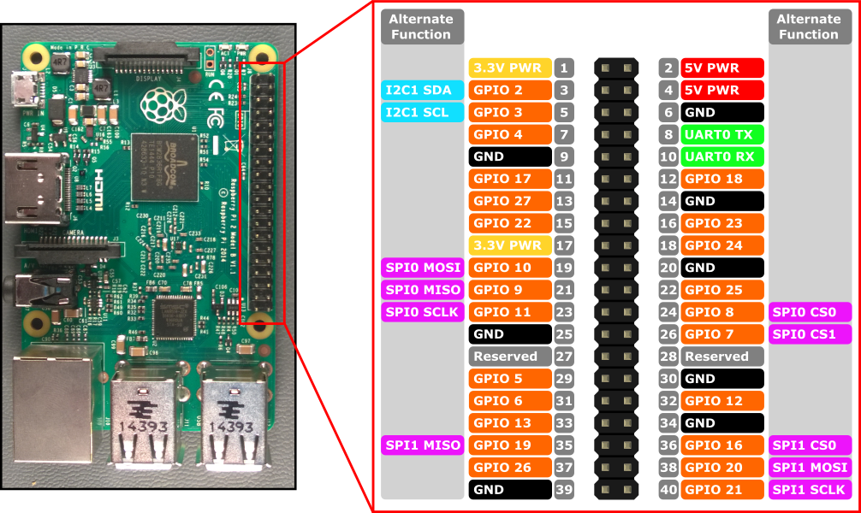
Raspberry Pi Pinout

Slide 11
Code

Slide 12


